Slide 1

Early detection of Twitter trends
milan stanojevic
sm123317m@student.etf.rs
university of Belgrade
school of electrical engineering

Slide 2
contents
Introduction
Trending topics
Parametric model
Data-Driven approach
Experiment results
Conclusion
Milan Stanojevic

Slide 3
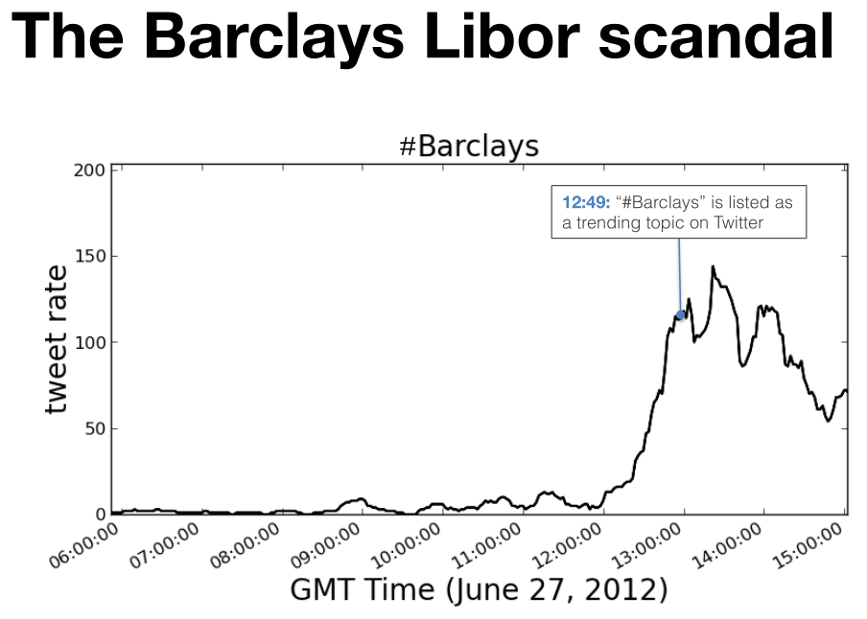
introduction
Events occur in large datasets
We need:
  detection
  classification
  prediction
Parametric models are popular but overly simplistic
Nonparametric approach is proposed for time series inference
Observed signal is compared to two sets of reference signals – positive and negative examples
Is there enough information for earlier prediction?
(spoiler alert: YES)
Milan Stanojevic

Slide 4


Trending topics
Twitter: a global communication network
Tweet: a short, public message
Topic: a phrase in a tweet
Trending topic (trend): a topic that becomes popular
Milan Stanojevic

Slide 5
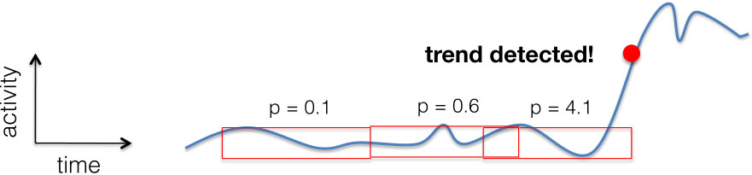
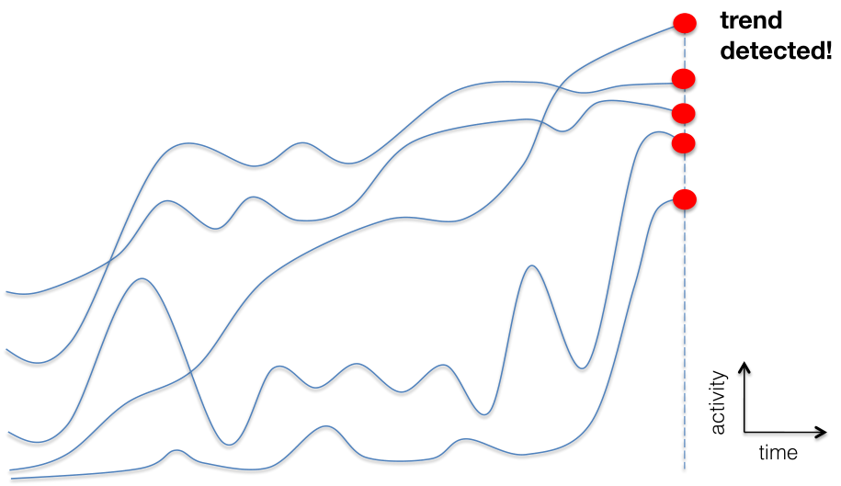
parametric model
Expect certain type of pattern
  usually constant + jumps
Fit parameter in data
  e.g. size of a jump
Milan Stanojevic

Slide 6
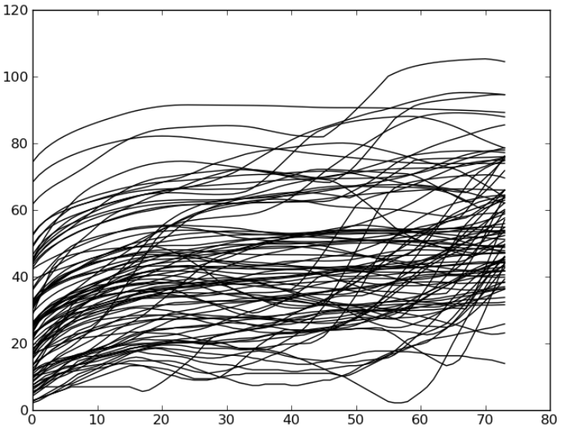
data-driven approach
All the information needed is in the data
Assumptions:
  tweets are written by people
  people are simple:
    in how they spread information
    in how they connect to each other
  there is a small number of distinct ways in which a topic becomes trending
Milan Stanojevic

Slide 7
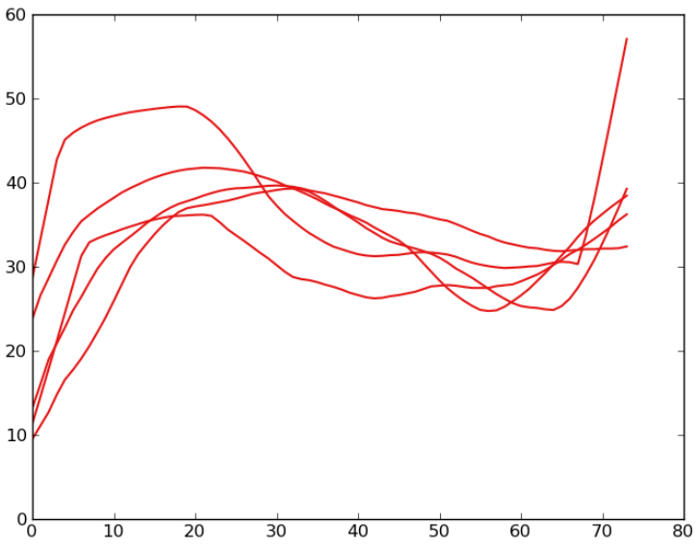
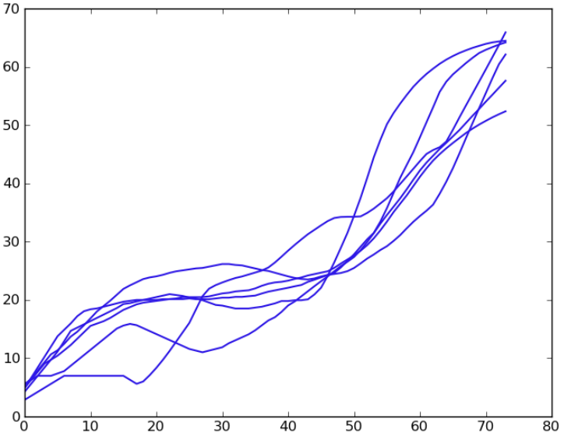
data-driven approach
Milan Stanojevic

Slide 8
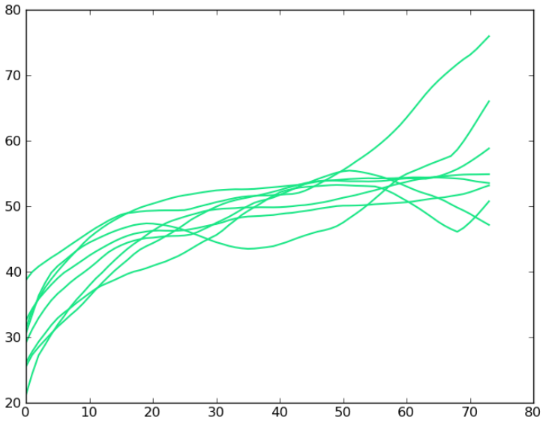
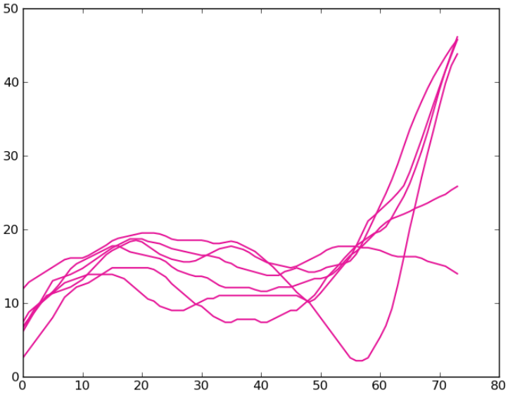
data driven approach
Milan Stanojevic

Slide 9
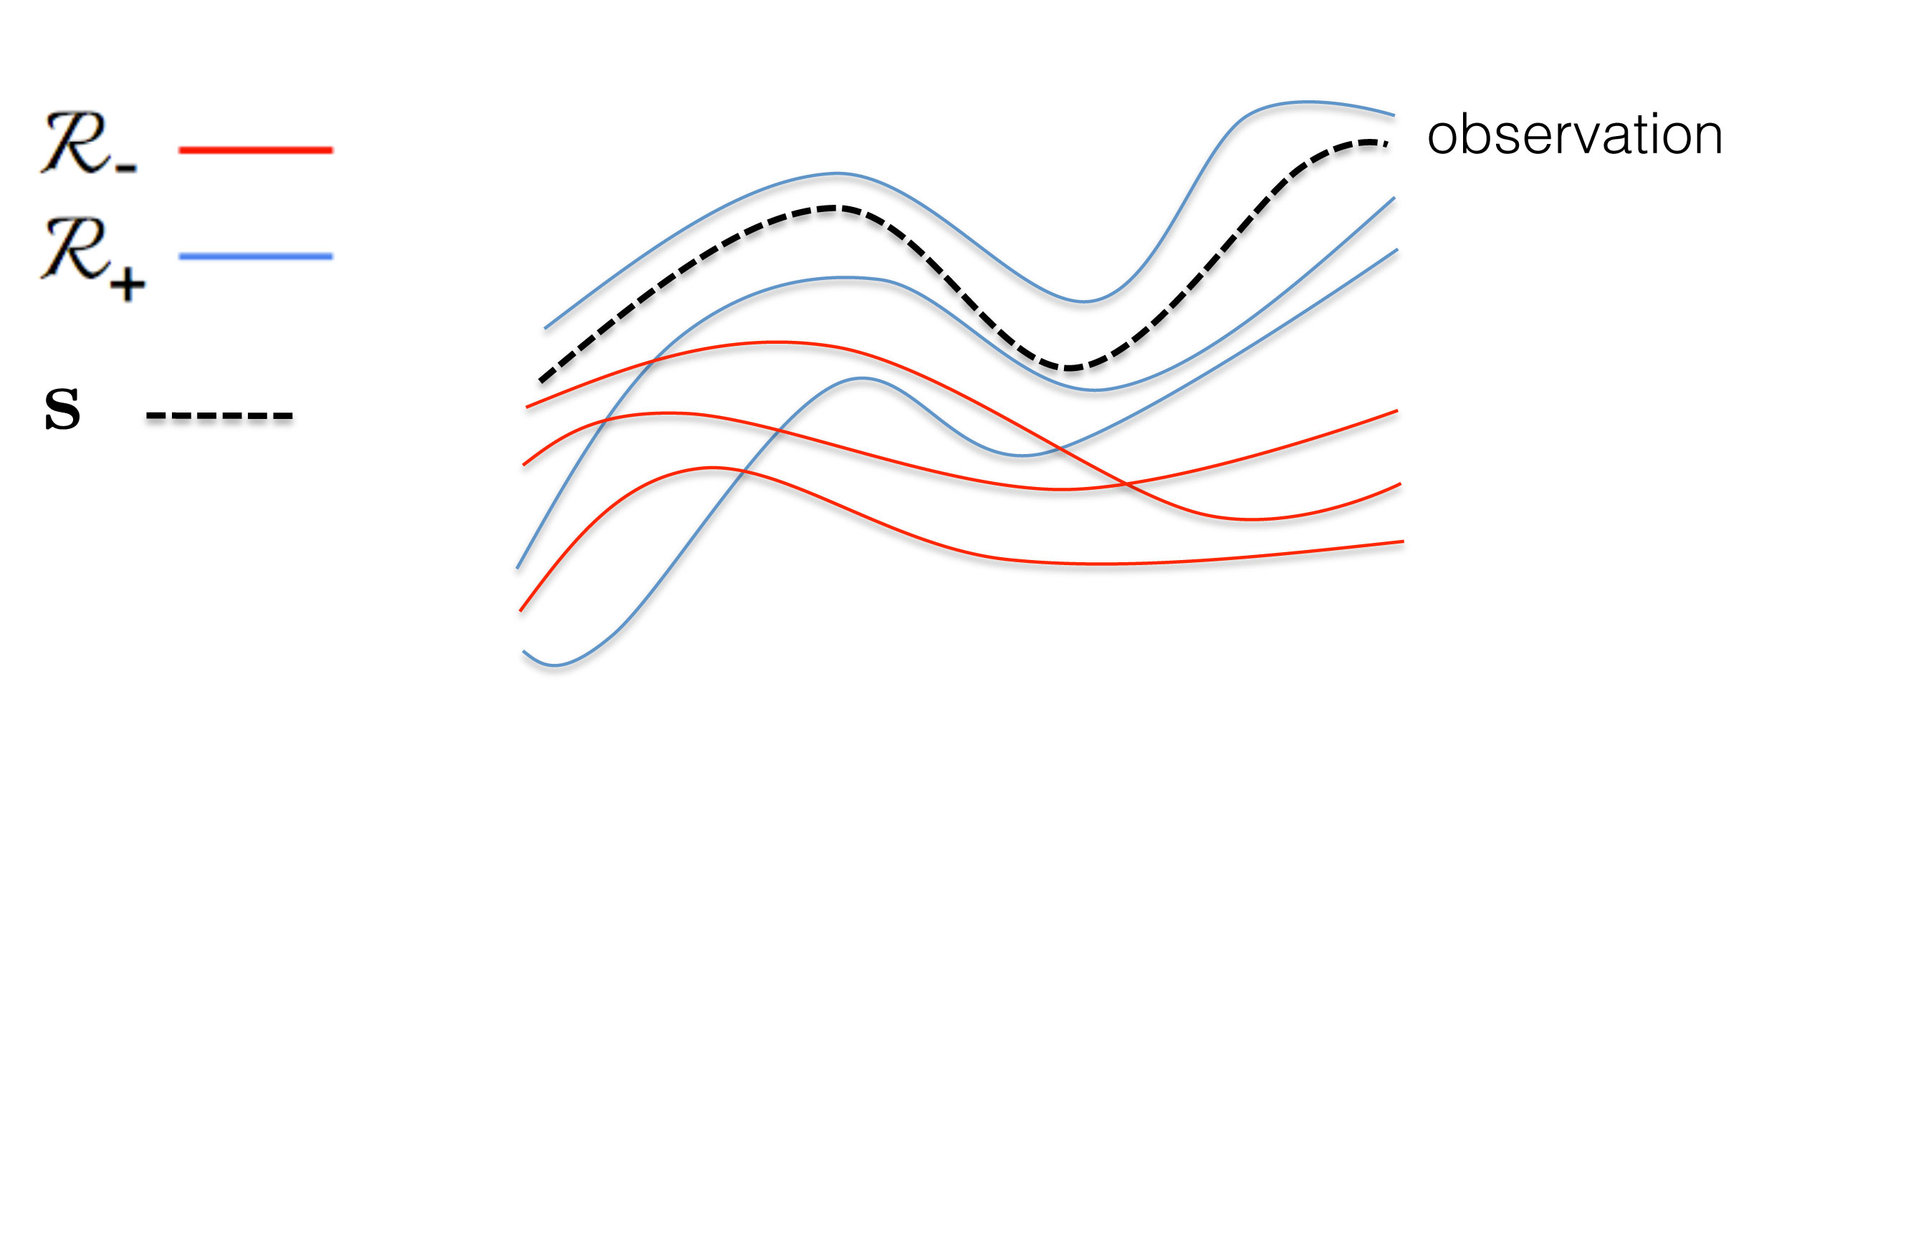
classification by experts
Milan Stanojevic

Slide 10
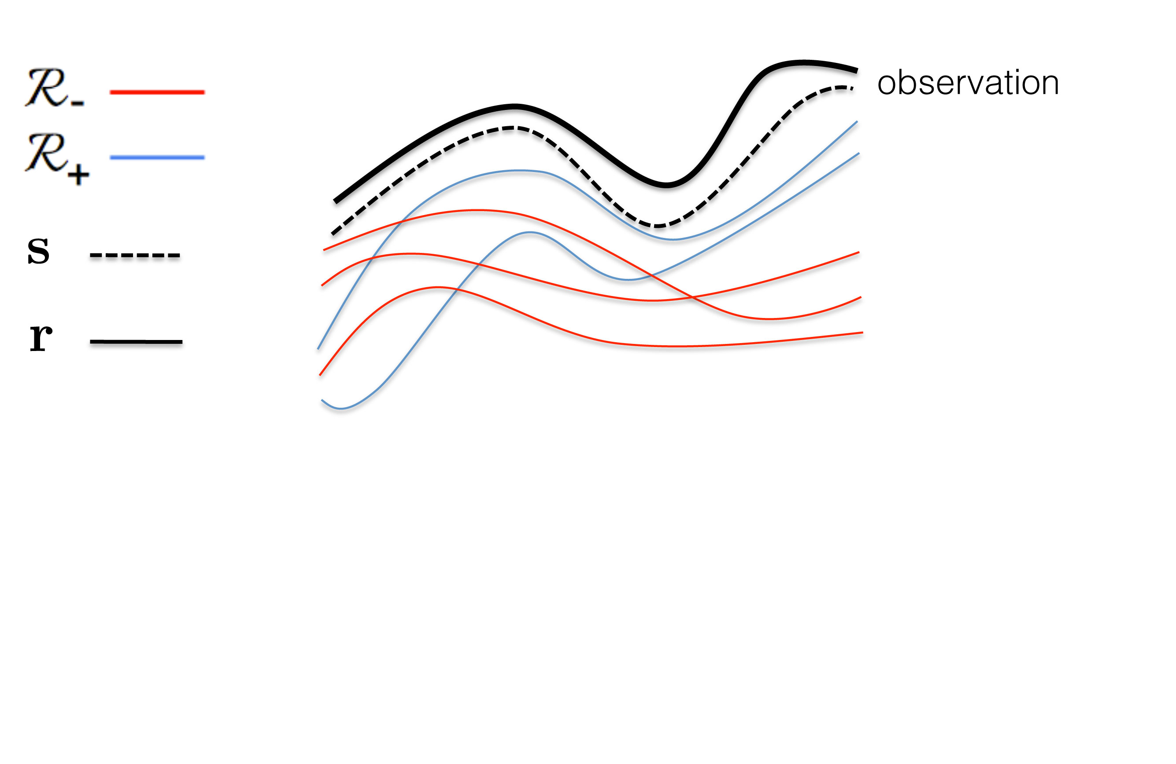
classification by experts
Milan Stanojevic

Slide 11
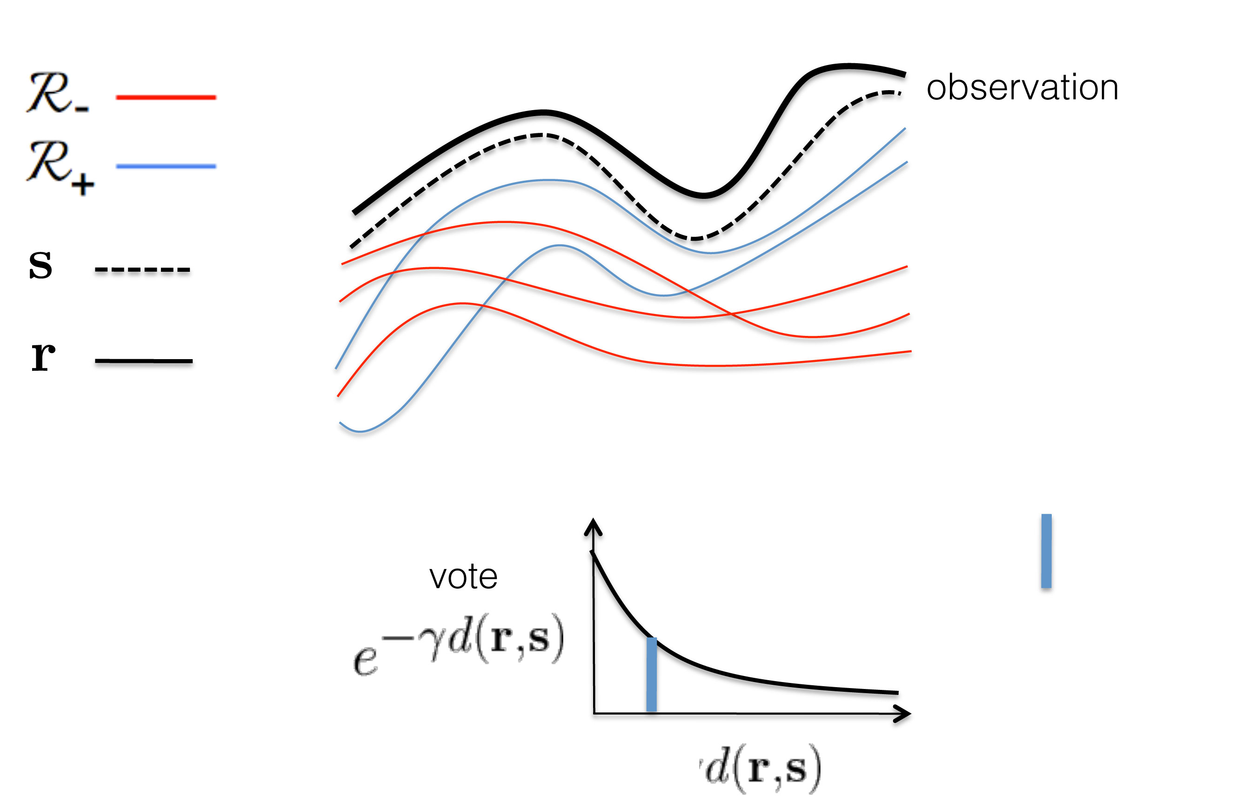
classification by experts
Milan Stanojevic

Slide 12
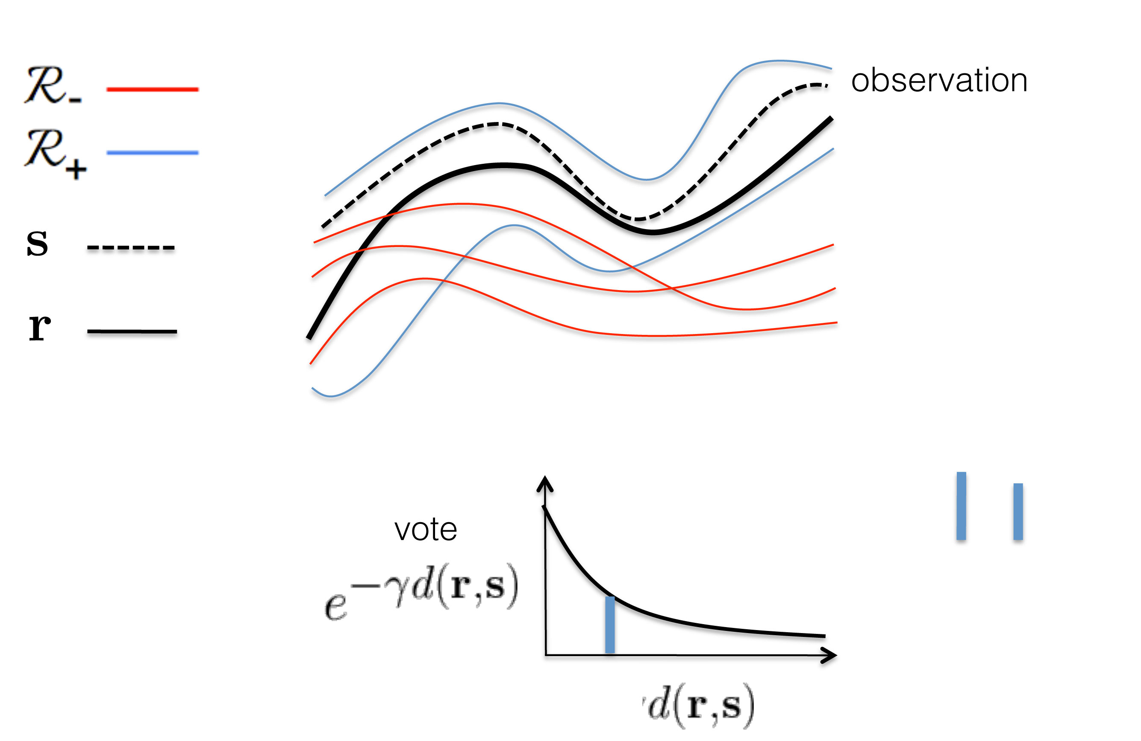
classification by experts
Milan Stanojevic

Slide 13
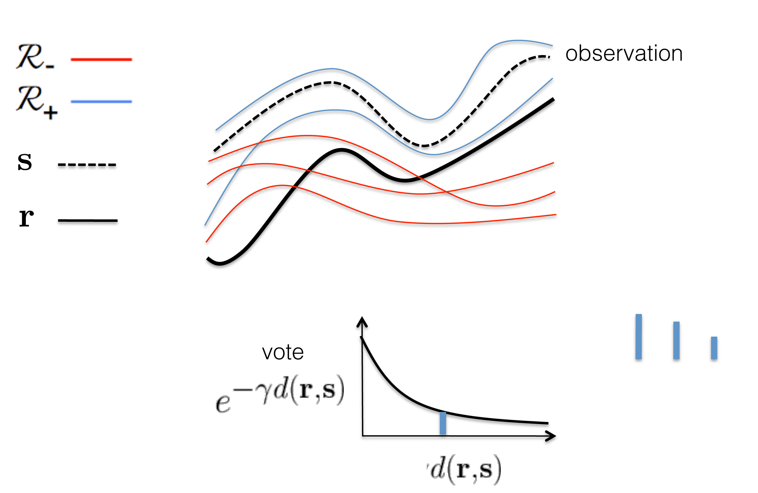
classification by experts
Milan Stanojevic

Slide 14
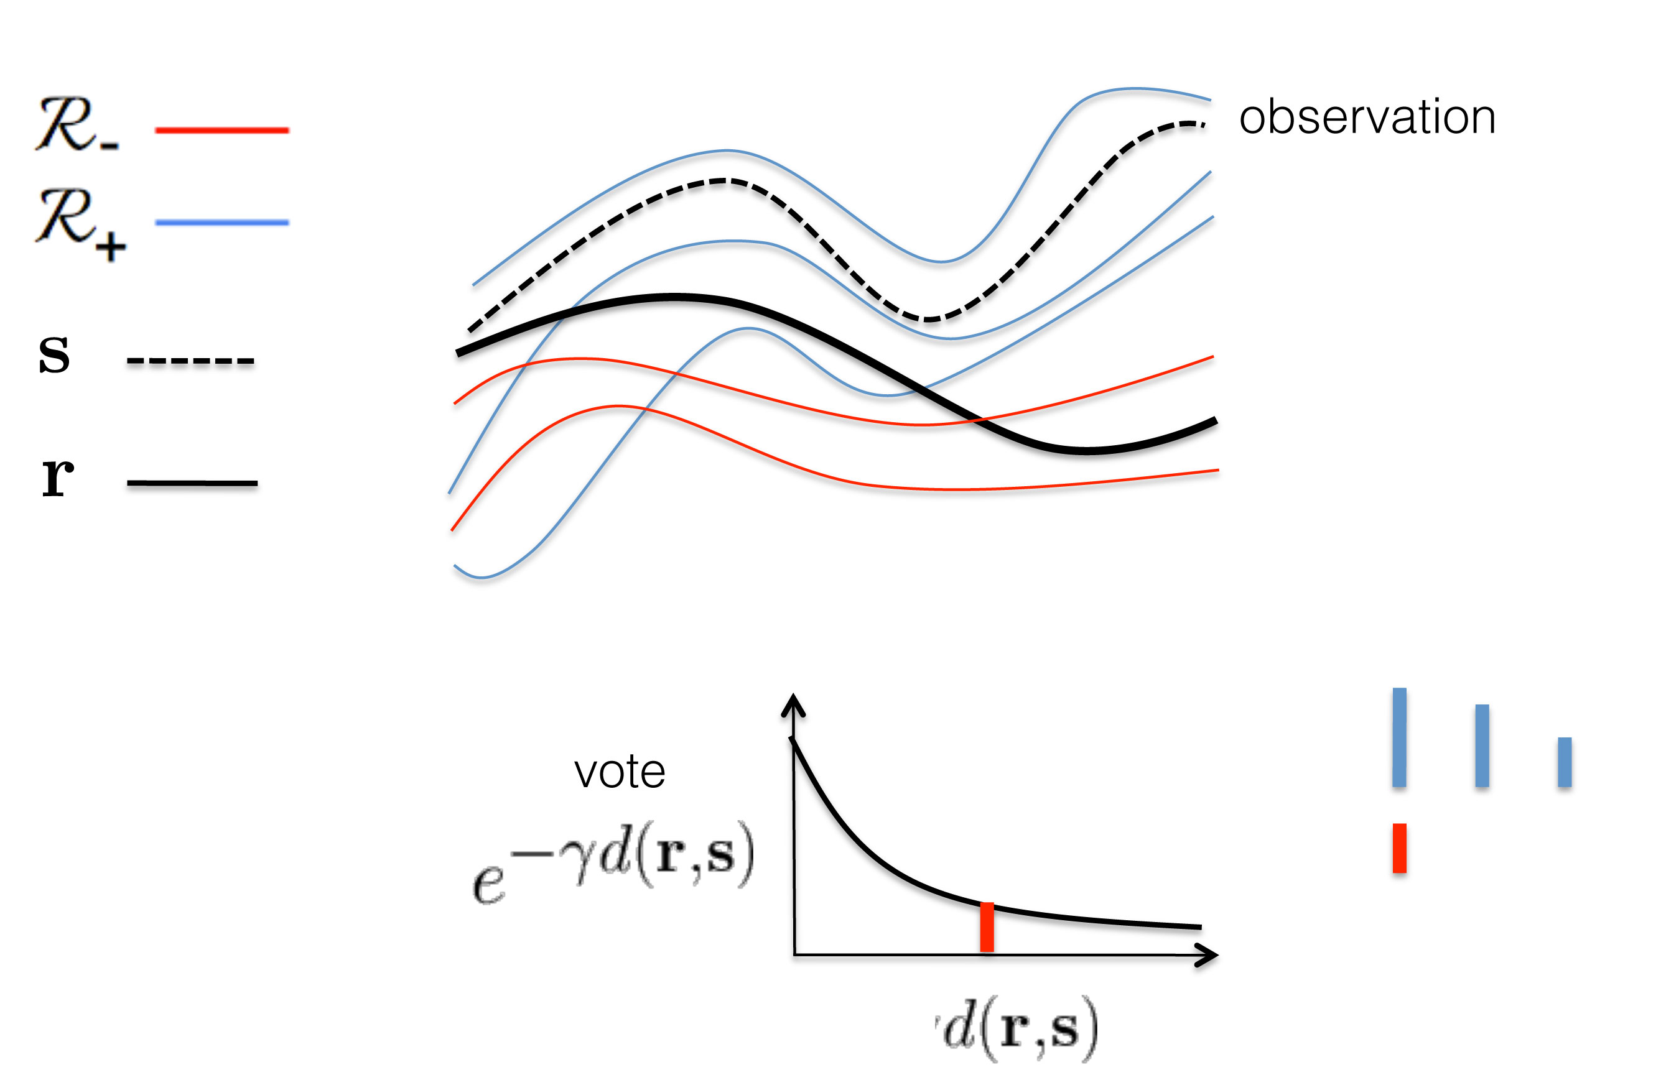
classification by experts
Milan Stanojevic

Slide 15
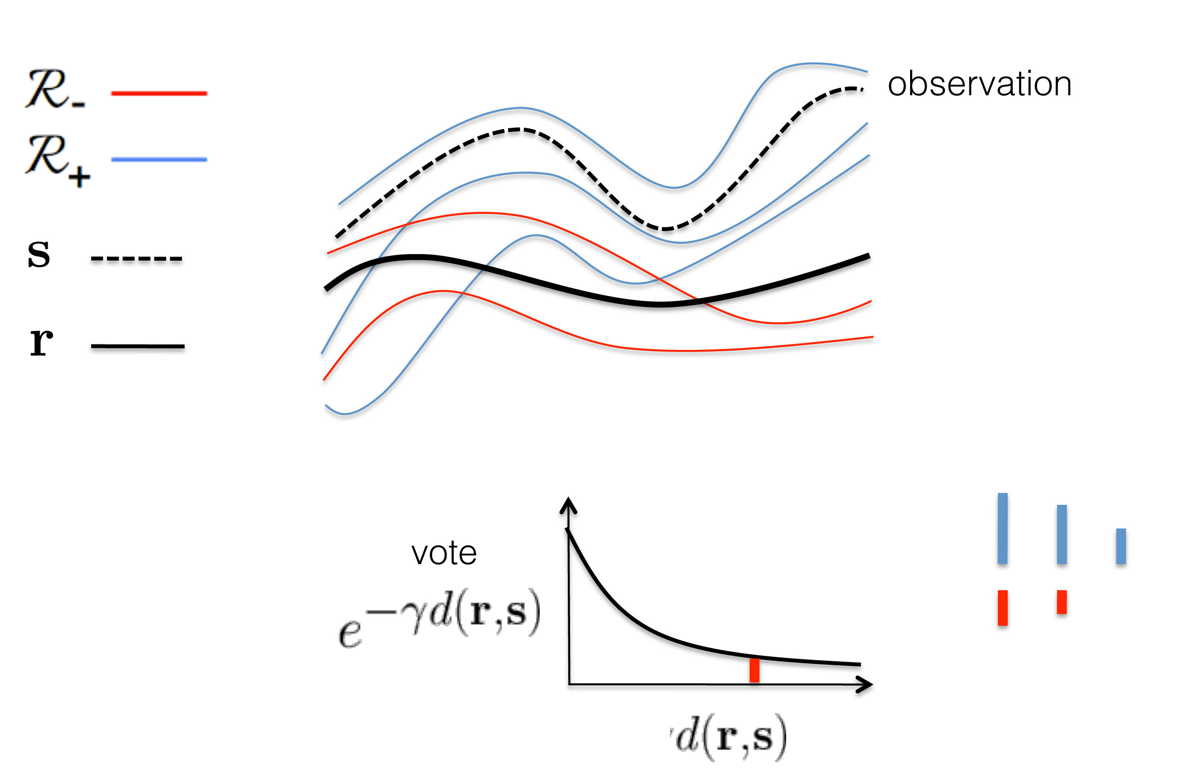
classification by experts
Milan Stanojevic

Slide 16
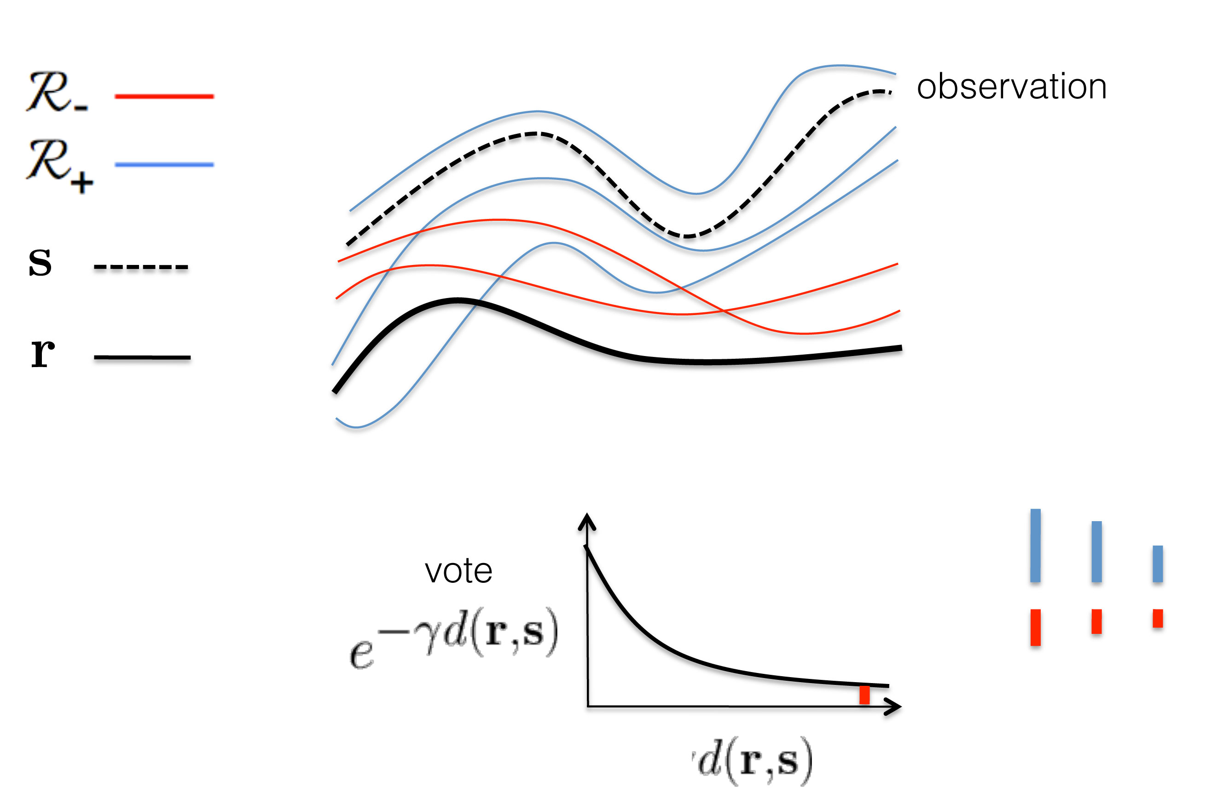
classification by experts
Milan Stanojevic

Slide 17
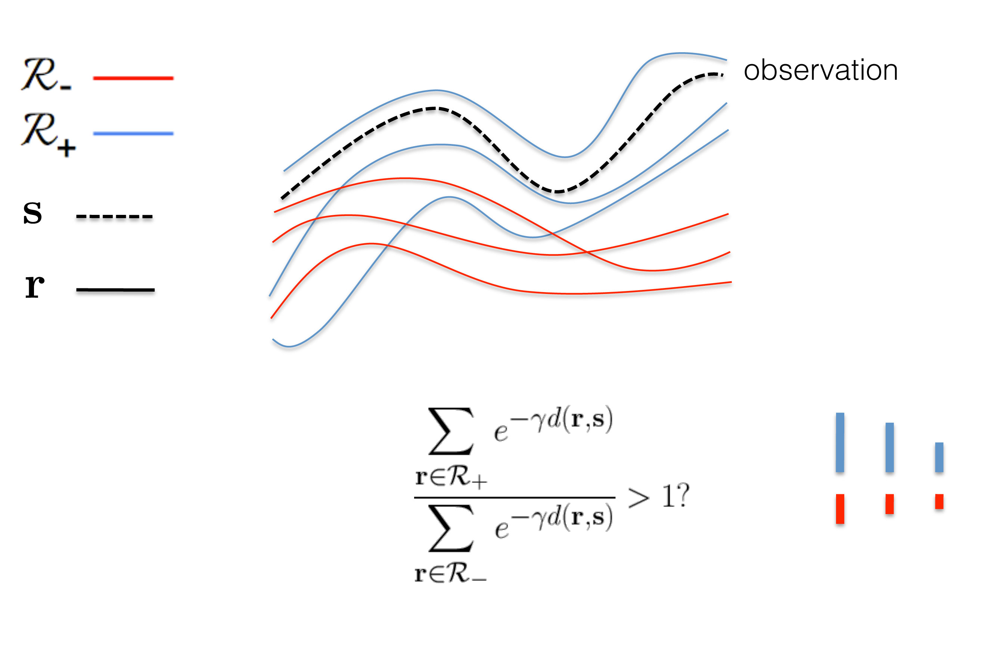
classification by experts
Milan Stanojevic

Slide 18
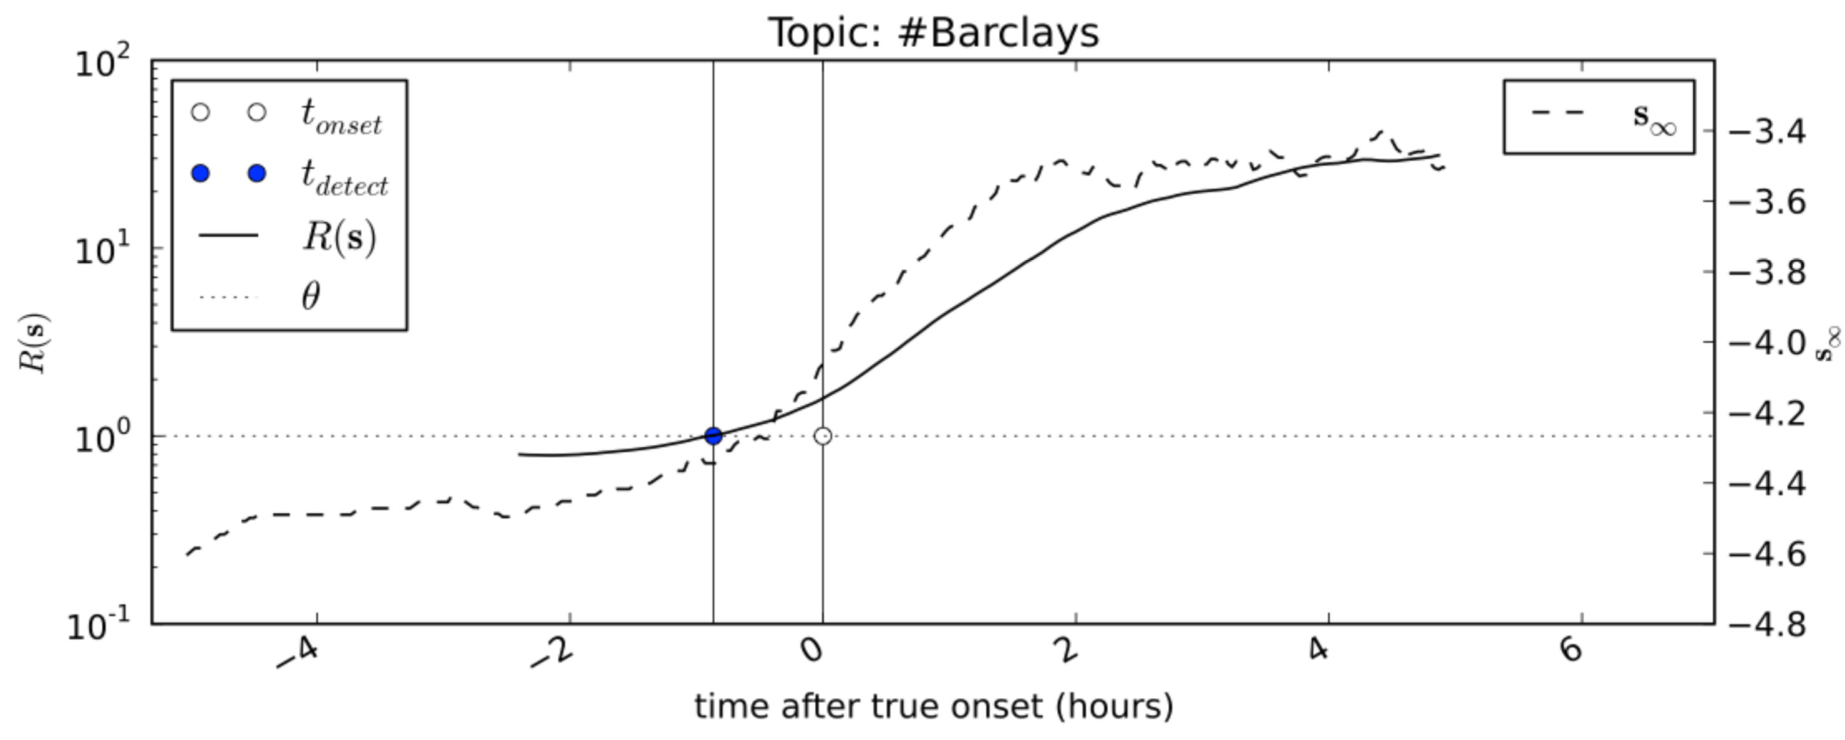
classification by experts
Properties
simple: computation of distances
scalable: computation is easily parallelized
nonparametric: model “parameters” scale along with the data
Milan Stanojevic

Slide 19
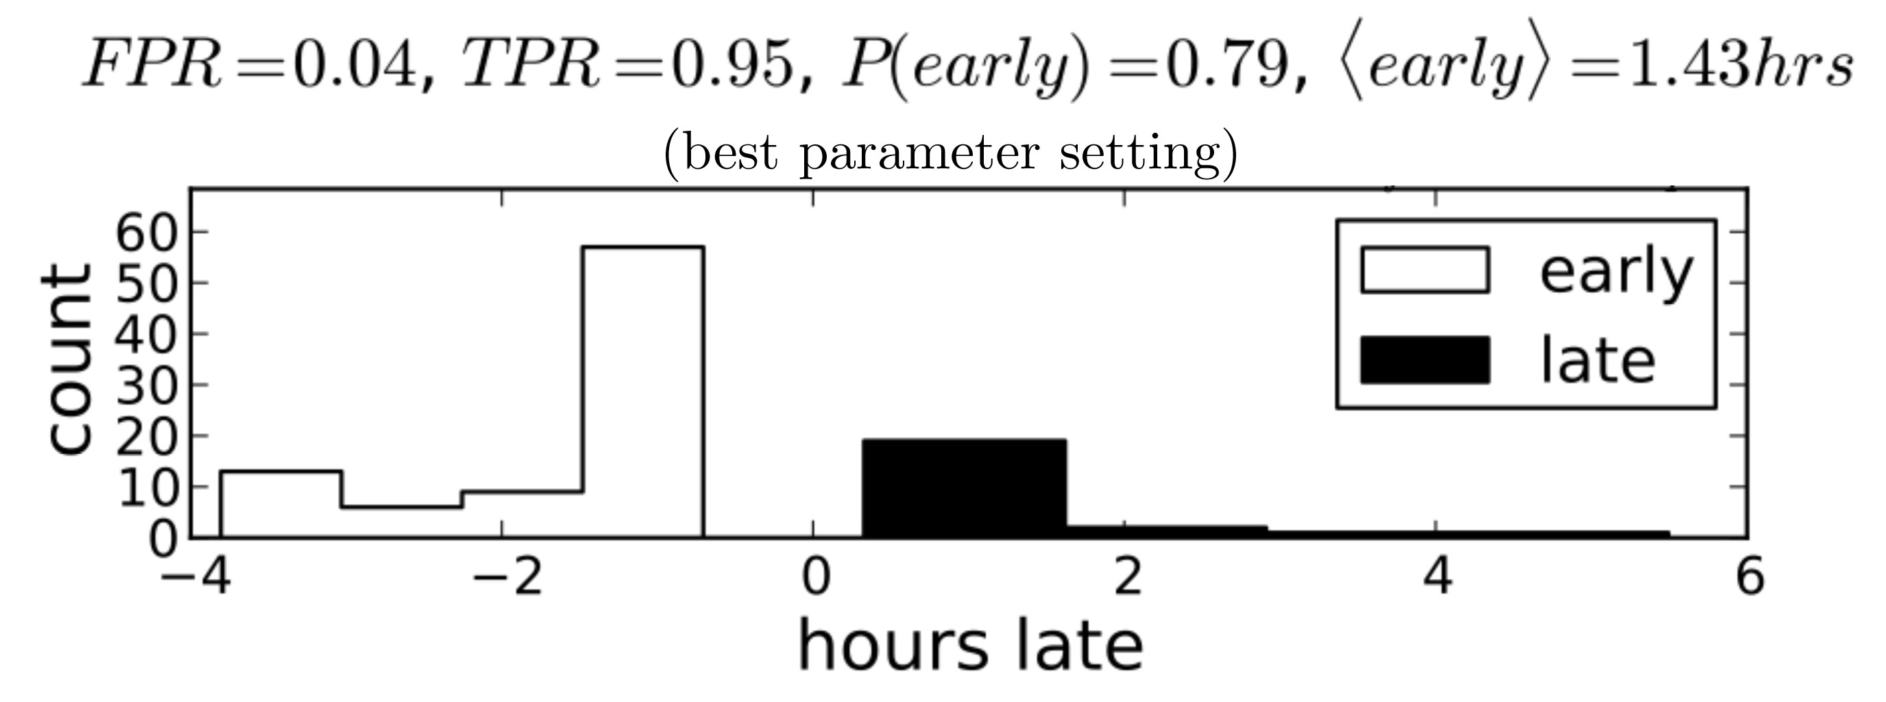
experiment
SETUP
Dataset:
  500 trends
  500 non-trends
Do trend detection of 50% holdout set of topics
Online signal classification
RESULTS
Early detection
  79% rate of early detection, 1.43hrs average
Low rate of error
  95% true positive rate, 4% false positive rate
Milan Stanojevic

Slide 20
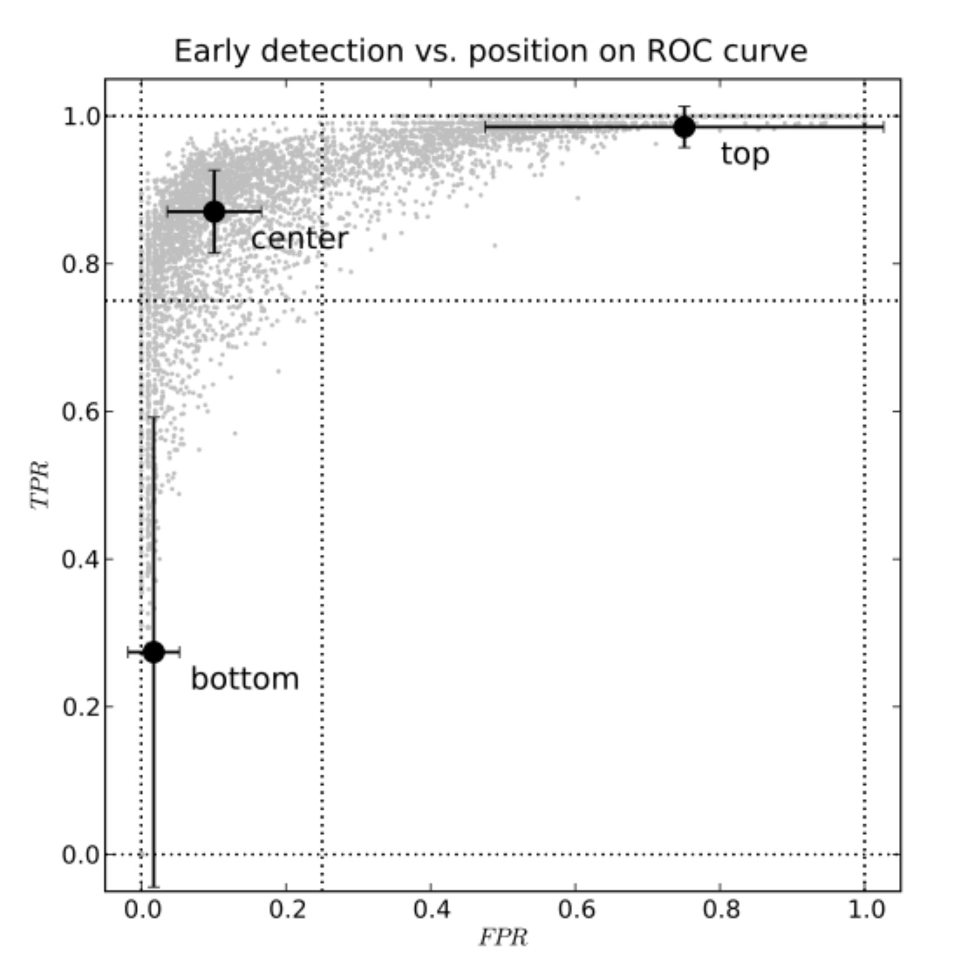
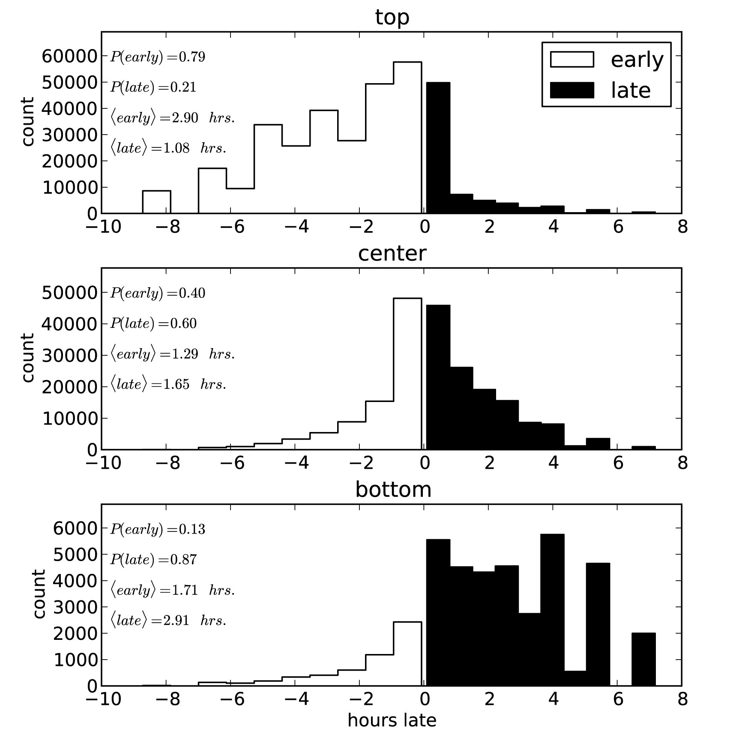
experiment
FPR / TPR Tradeoff
Early / Late Tradeoff
Milan Stanojevic

Slide 21
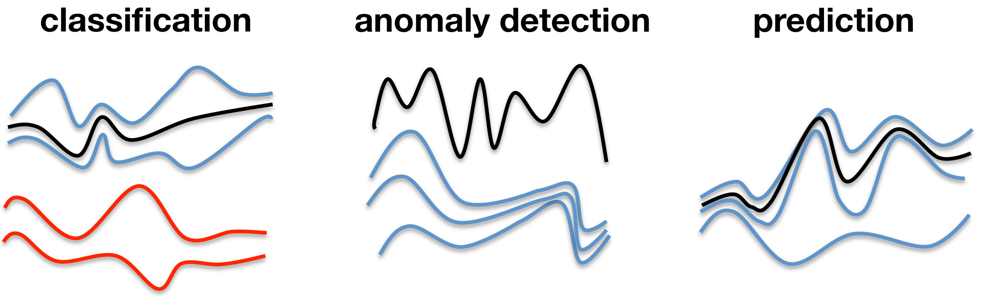
conclusion
New approach to detecting Twitter trends
Generalized time series analysis method:
  Classification
  Prediction
  Anomaly detection
Possible applications:
  Movie ticket sales
  Stock prices
  etc.
Milan Stanojevic

Slide 22
Bibliography
Trend or No Trend: A Novel Nonparametric Method for Classifying Time Series
Stanislav Nikolov
Master thesis
Massachusetts Institute of Technology (2011)
Milan Stanojevic
sm123317m@student.etf.rs

